Slide 1
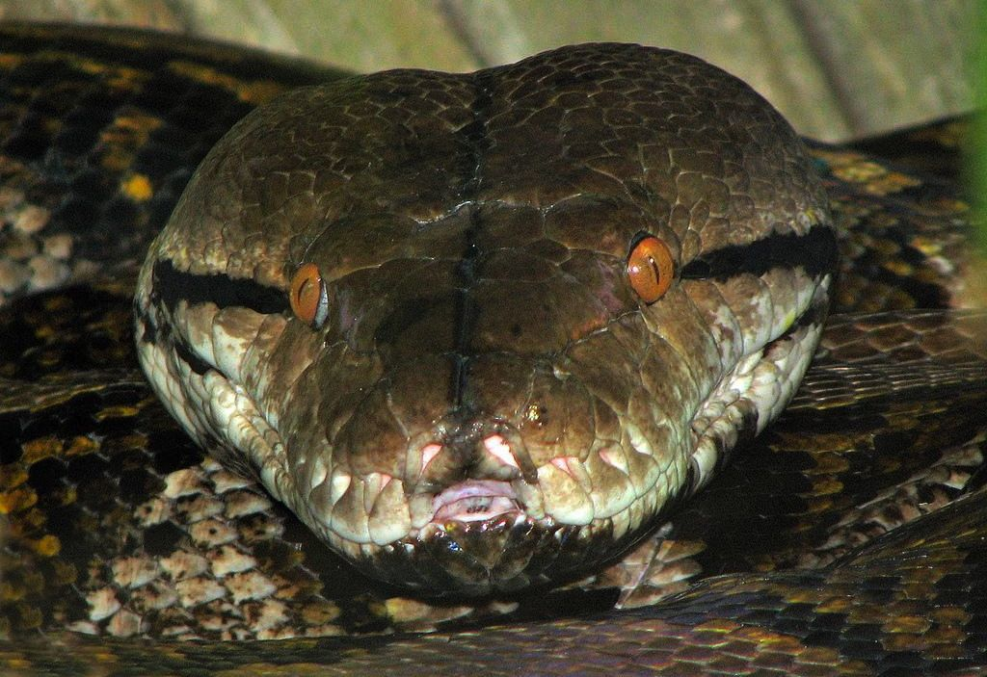
CHAPTER - II WORKING WITH FUNCTIONS

Slide 2
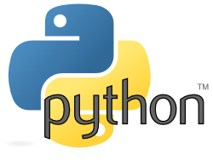
REFERENCE BOOK SUMITA ARORA

Slide 3
What is Function?

Slide 4
What is Function?
A function is a group of statements that is executed when it is called from some point of the program.
It’s a divide and conquer approach

Slide 5
TYPES OF FUNCTIONS

Slide 6
TYPES OF FUNCTIONS
Functions can be categorized into three types:-
1) Built in Functions.
2) Modules.
3) User - defined functions.

Slide 7
TYPES OF FUNCTIONS
1) BUILT IN FUNCTIONS
These are predefined function in python and are used as and when there is need by simply calling them. For example:
int() float() str() min() max() ...etc

Slide 8
TYPES OF FUNCTIONS
2) MODULES
Module is a container of functions, variables, constants, class in a separate file which can be reused.

Slide 9
IMPORTING MODULES
i) Import statement ii) from statement

Slide 10
IMPORTING MODULES – import STATEMENT
i) import statement : used to import entire module. Syntax: import modulename example: import math

Slide 11
IMPORTING MODULES – import STATEMENT
ii) from: import all functions or selected one. Syntax: from module name import function name for example: from random import randint

Slide 12
3) USER DEFINED FUNCIONS
Function is a set of statements that performs specific task.
Syntax of user defined function
def function_name(list of parameters) ................ ................ Statements
def is keyword

Slide 13
3) USER DEFINED FUNCIONS
def sum_diff(x,y): add=x+y diff=x-y return add,diff
def main(): x=9 y=3 a,b=sum_diff(x,y) print("Sum = ",a) print("diff = ",b) main()

Slide 14
PARAMETERS AND ARGUMENTS IN FUNCTION
Parameters are the values which are provided at the time of function definition.
def sum_diff(p,q): add=p+q diff=p-q return add,diff
Parameters
Parameter is also called as formal parameter

Slide 15
PARAMETERS AND ARGUMENTS IN FUNCTION
Arguments are the values which are passed while calling a function
def main(): x=9 y=3 a,b=sum_diff(x,y) print("Sum = ",a) print("diff = ",b) main()
Arguments
Argument is also called as actual parameter

Slide 16
Python supports following type of arguments:
TYPES OF ARGUMENTS
Positional arguments
Default Arguments
Keyword Arguments
Variable Length Arguments

Slide 17
These are the arguments passed to a function in correct positional order
1. POSITIONAL ARGUMENTS
For example:
def substract(a,b):
print(a-b)
substract()
>>substract(100,200)
-100
>>substract(150,100)
50

Slide 18
When a function call is made without arguments, the function has defalut values for it for example:
2. DEFAULT ARGUMENTS
For example:
def greet_msg(name=“Mohan”):
print(“Hello “, name)
greet_msg(“Vinay”) # valid
greet_msg() #valid

Slide 19
When a function call is made without arguments, the function has default values for it for example:
2. DEFAULT ARGUMENTS
For example:
def greet_msg(name=“Mohan”,msg=“GoodMorning”):
print(name,msg)
greet_msg()
def greet_msg(name=“Mohan”,msg): # invalid
print(name,msg)
greet_msg()

Slide 20
if function containing many arguments, and we wish to specify some among them, then value for such parameter can be provided by using the name
3. KEYWORD ARGUMENTS
For example:
def greet_msg(name,msg):
print(name,msg)
#calling function
greet_msg(name=“Mohan”,msg=“Hi”): # valid
O/p -> Mohan Hi

Slide 21
3. KEYWORD ARGUMENTS
For example:
#calling function
greet_msg(msg=“Hi”,name=“Mohan”): # valid
O/p -> Mohan Hi

Slide 22
4. VARIABLE LENGTH ARGUMENTS
In some situation one needs to pass as many as argument to a function, python provides a way to pass number of argument to a function, such type of arguments are called variable length arguments.
Variable length arguments are defined with * symbol.
For Example: (next slide)

Slide 23
4. VARIABLE LENGTH ARGUMENTS
For Example:
def sum(*n):
total=0
for i in n:
total+=i
print(“Sum = “, total)
sum()
# Calling function
sum() o/p sum=0
sum(10) o/p sum=10
sum(10,20,30,40) o/p sum=100

Slide 24
PASSING ARRAYS/LISTS TO FUNCTIONS
Arrays in basic python are lists that contain mixed data types and can be passed as an argument to a function.
For Example: # Arithmetic mean of list
def list_avg(lst):
l=len(lst)
sum=0
for i in lst:
sum+=i
return sum/l
def main():
print(“Input integers”)
a=input()
a=a.split()
for i in range(len(a) ):
a[i]=int(a[i])
avg=list_ave(a)
print (“Average is = “, avg)

Slide 25
SCOPE OF VARIABLES
Scope mean measure of access of variable or constants in a program. Generally there are two types of scope of variables:
i) Global (Module)
ii) Local (Function)
Global variables are accessed throughout the program their scope is global
Local variables are accessed within the program and their scope is local only.

Slide 26
GLOBAL VARIABLES & LOCAL VARIABLES
For Example:
def main():
x=9
y=3
a,b=add_diff(x,y)
print("Sum = ",a)
print("diff = ",b)
print("m in main function = ",m)
main()
GLOBAL VARIABLE
LOCAL VARIABLES
m=100
def add_diff(x,y):
add=x+y
diff=x-y
global m
m= m +10
print("m in add_diff function=",m)
return add,diff

Slide 27
Class Test
Which of the following is the use of function in python?
a) Functions are reusable pieces of programs b) Functions don’t provide better modularity for your application c) you can’t also create your own functions d) All of the mentioned
2. Which keyword is use for function? a) Fun b) Define c) def d) Function

Slide 28
Class Test
3. What is the output of the below program?
def sayHello():
print('Hello World!')
sayHello()
sayHello()
a) Hello World! Hello World! b) ‘Hello World!’ ‘Hello World!’ c) Hello Hello

Slide 29
Class Test
4. What is the output of the below program?
def printMax(a, b):
if a > b:
print(a, 'is maximum')
elif a == b:
print(a, 'is equal to', b)
else:
print(b, 'is maximum')
printMax(3, 4)
a) 3 b) 4 c) 4 is maximum d) None of the mentioned

Slide 30
Class Test
5. What is the output of the below program ?
x = 50
def func(x):
print('x is', x)
x = 2
print('Changed local x to', x)
func(x)
print('x is now', x)
a) x is now 50 b) x is now 2 c) x is now 100 d) None of the mentioned

Slide 31
Class Test
6. What is the output of the below program?
x = 50
def func():
global x
print('x is', x)
x = 2
print('Changed global x to', x)
func()
print('Value of x is', x)
a) x is 50 Changed global x to 2 Value of x is 50 b) x is 50 Changed global x to 2 Value of x is 2 c) x is 50 Changed global x to 50 Value of x is 50 d) None of the mentioned

Slide 32
Class Test
7. What is the output of below program?
def say(message, times = 1):
print(message * times)
say('Hello')
say('World', 5)
a) Hello WorldWorldWorldWorldWorld b) Hello World 5
c) Hello World,World,World,World,World d) Hello HelloHelloHelloHelloHello

Slide 33
Class Test
8. What is the output of the below program?
def func(a, b=5, c=10):
print('a is', a, 'and b is', b, 'and c is', c)
func(3, 7)
func(25, c = 24)
func(c = 50, a = 100)
a) a is 7 and b is 3 and c is 10 a is 25 and b is 5 and c is 24 a is 5 and b is 100 and c is 50
b) a is 3 and b is 7 and c is 10 a is 5 and b is 25 and c is 24 a is 50 and b is 100 and c is 5 c) a is 3 and b is 7 and c is 10 a is 25 and b is 5 and c is 24 a is 100 and b is 5 and c is 50 d) None of the mentioned

Slide 34
Class Test
9. What is the output of below program?
def maximum(x, y):
if x > y:
return x
elif x == y:
return 'The numbers are equal'
else:
return y
print(maximum(2, 3))
2 b) 3 c) The numbers are equal
d) None of the mentioned

Slide 35
Class Test
1 A
2 C
3 A
4 C
5 A
6 B
7 A
8 C
9 B

Slide 36
#Find the output of the following
def change(P,Q=30):
P=P+Q
Q=P-Q
print(P,'#',Q)
return P
A=150
B=100
A=change(A,B)
print(A,'#',B)
B=change(B)

Slide 37
#Find the output of the following
def fun(s):
k=len(s)
m=''
for i in range (0,k):
if(s[i].isupper()):
m=m+s[i].lower()
elif (s[i].isalpha()):
m=m+s[i].upper()
else:
m=m+'bb'
print(m)
fun('@gmail.com')

Slide 38
Thank You

